Slide 1


Start Smart 1.0
4th Grade
Lesson 8

Slide 2

ELD Objective
ELD Objective: Students will be able to engage in a Constructive Conversation using the Constructive Conversation Skill of FORTIFY, by taking turns, sharing ideas and making ideas clearer with a partner based on a visual text.

Slide 3
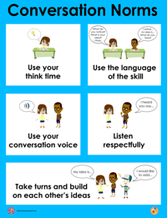
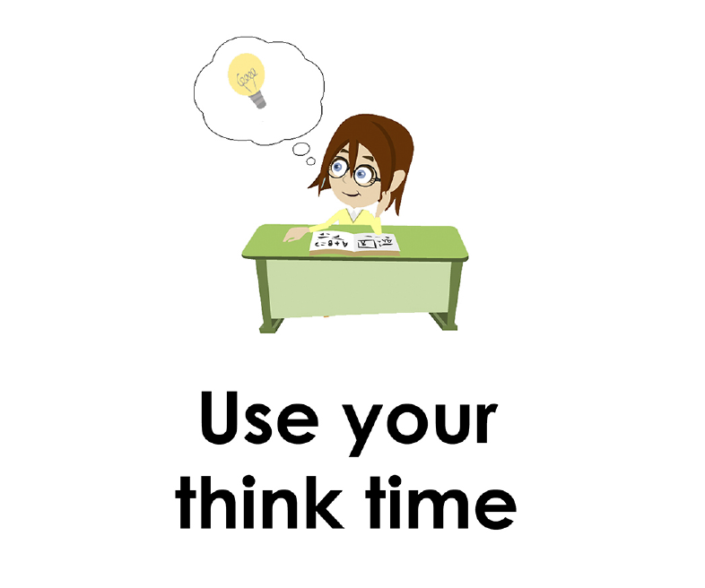
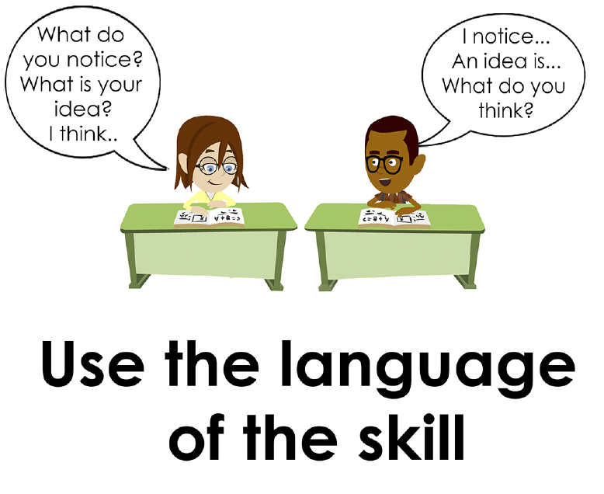
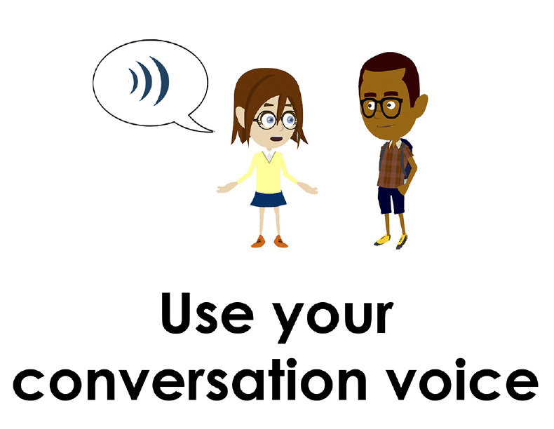
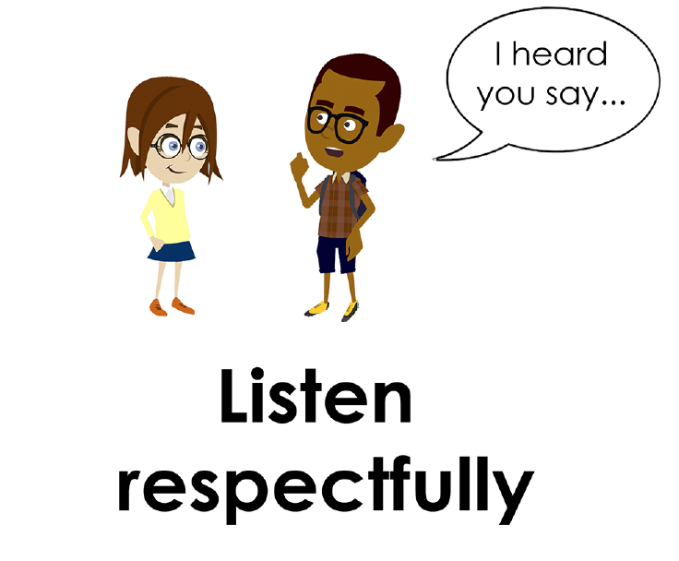
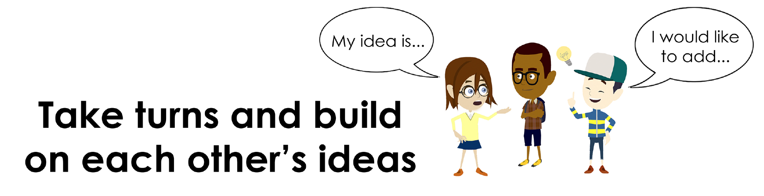
Conversation Norms Poster
  Use your think time
  Use the language of the skill
  Use your conversation voice
  Listen respectfully
  Take turns and build on each other’s ideas

Slide 4
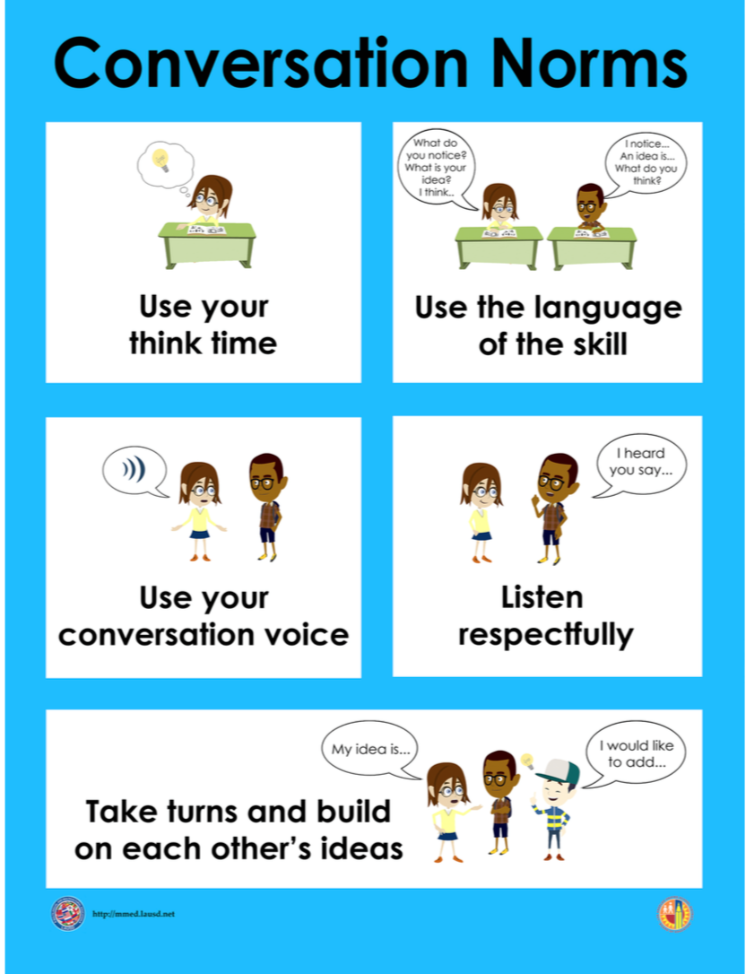
Notes:
The focus today is:
Use your think time
Use the language of the skill

Slide 5
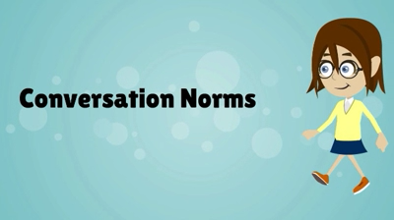
Conversation Norms
Notes:
Show Constructive Conversation Norms Video as a review of all norms

Slide 6
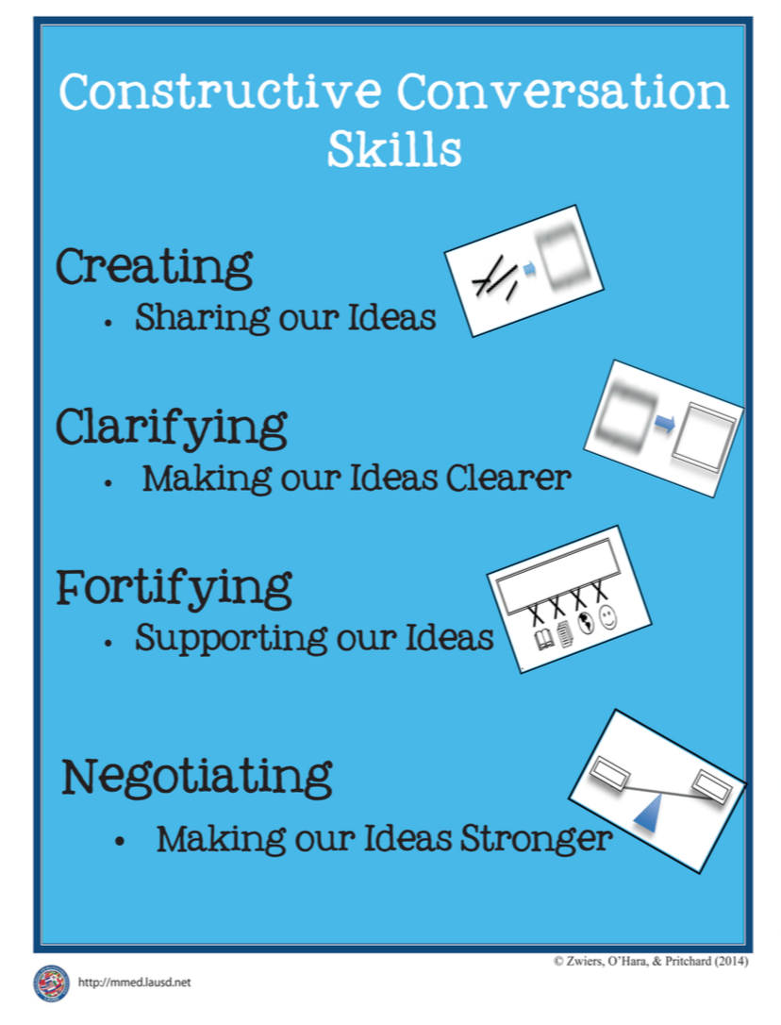
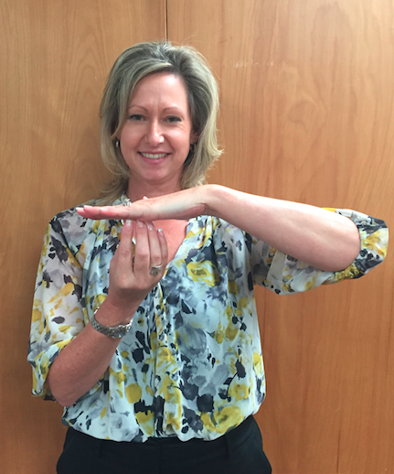
Hand Gesture and Phrase- FORTIFY
Supporting Our Ideas
Notes:
Model FORTIFY and have participants repeat with you:
Place hand, palm down in front of you as if putting an idea on the table. Use four fingertips of the other hand to support the palm.

Slide 8
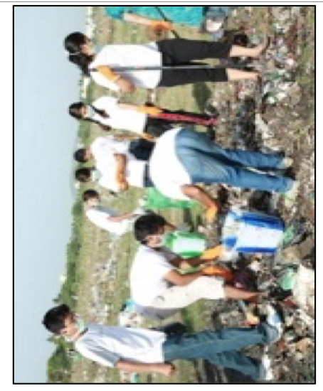
Prompt:
What is happening in this visual text? Provide evidence from the text to support your claim.
TEACHER VISUAL TEXT

Slide 9


Listen to the Model Constructive Conversation
  Use your think time to study the visual text.
Listen actively to what two partners say to each other.
Notes:
Provide a copy of the Model Script to the volunteer and allow time beforehand for student to review the script. Suggestions for reading the script:
● Show a video of students having the model conversation (optional)
● Student volunteer and teacher read model script
STUDENT LISTEN ACTIVELY

Slide 10
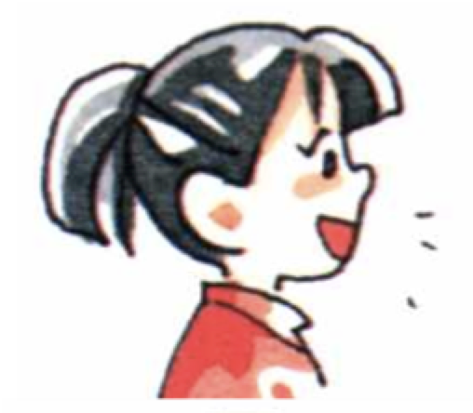
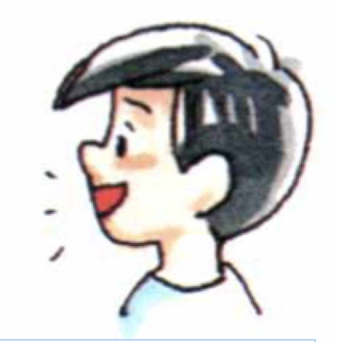
Visual Text Model
What is happening in this visual text. Provide evidence from the text to support your claim.
Partner A: What is happening in the visual text is that all kids are out on an environmental clean-up field trip with their class. What do you think is happening in the visual text?
Partner A: I notice teenagers picking up trash in a field of grass. All the teenagers are wearing T-shirts. I also notice there is a woman with a blue dress off to the side. I think this is the teacher and she is supervising them. What evidence are you using for your claim?
Partner A: I notice the teenagers are wearing gloves and face masks. They also brought rakes and containers where they are placing the trash. I think this shows that they came prepared to clean up together as a group. Can you show me where you find evidence that supports that teenagers are collecting recyclable materials?
Partner A: I think what is happening in the text is that a class of teenagers and their teacher are on an environmental clean-­up.
Partner B: An idea I have is that all the teenagers are out collecting recyclable materials with their class. Can you provide some evidence from the text to support your claim?
Partner B: Two students are placing items in the green bag while two more students are putting items into a blue bucket. I think they are placing items away to recycle them. What can you add to your claim?
Partner B: There is a green and blue bucket. There is also a green bag. The teenagers are also bending over to pick up trash and to place it in the containers. I think they are sorting through the trash looking for recyclables.
Partner B: Based on the evidence I cited from the visual text, I think the teacher is leading the class as they collect and sort materials for recycling.

Slide 12
Listen to the Non-Model Constructive Conversation
  Use your think time to study the visual text.
Listen actively to what two partners say to each other.
Notes:
Provide a copy of the Non-­‐‑Model Script to the volunteer and allow time beforehand for student to review the script. Suggestions for reading the script:
● Show a video of students having the model conversation (optional)
● Student volunteer and teacher read model script
STUDENT LISTEN ACTIVELY

Slide 13
Visual Text Non- Model
What is happening in this visual text. Provide evidence from the text to support your claim.
Partner A: The kids are cleaning up a soccer field. What is happening in the visual text?
Partner A: I see a lot of trash.
Partner A: There is so much trash and it looks disgusting.
Partner A: Why do they have gloves?
Partner B: I see a bunch of kids. Now you go.
Partner B: Kids have buckets and rakes.
Partner B: Their shoes will get dirty.
Partner B: I think they have gloves so they don’t get dirty.

Slide 14

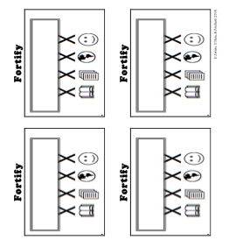
Constructive Conversation Game
PROMPT:
What is happening in this visual text? Provide evidence from the text to support your claim.
Rules of the game:
Each of you needs 1 CREATE, 2 CLARIFY and 3 FORTIFY cards
Each of you will play one card as you share your CREATE, CLARIFY and FORTIFY ideas. You will continue taking turns until all cards are placed in the middle.
If you’re done early repeat the process for an additional round.
Remember to use the Constructive Conversation Norms and Skills as you play the game.
Notes:
You are now going to have the opportunity to practice the Constructive Conversation Skill FORTIFY while playing a game.
Explain the rules of the Constructive Conversation Game to students.

Slide 15
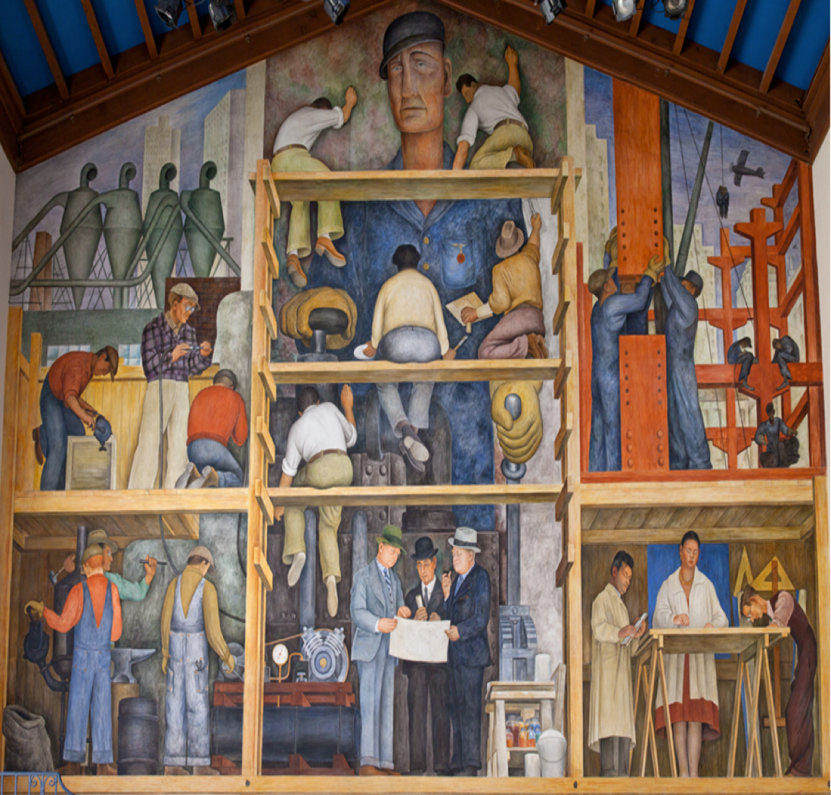

Prompt: What is happening in this visual text? Provide evidence from the text to support your claim.
TEACHER COLLECTS LANGUAGE SAMPLE SPF 1.0
STUDENT VISUAL TEXT
Notes:
Display the Student Visual Text
Direct students to use their Think Time
As the students play the game, the teacher listens and selects two students who will replay the game in front of the class to serve as models.
This is an opportunity to capture a language sample.

Slide 16


CONSTRUCTIVE CONVERSATION
FISHBOWL MODEL
PROMPT: What is happening in this visual text. Provide evidence from the text to support your claim.
Listen actively to what two partners say to each other.
FORMATIVE ASSESSMENT– TEACHER COLLECTS LANGUAGE SAMPLE SPF 1.0
Notes:
The two selected students will replay the game in front of the class and serve as models.
Student Progress Form (SPF)-­‐‑ Constructive Conversation Language Sample The teacher will collect a language sample from the two students on the Student Progress Form (SPF)-­‐‑ Constructive Conversation Language Sample to be used in Lesson 2. The language sample must be at least four turns in length. (Each turn includes both Partner A and B sharing

Slide 17
WRAP-UP
How did we meet today’s objective of using the Constructive Conversation Skill of FORTIFY?
How did you:
    Use your think time?
    Use the language of the skill
  Work with your conversation partner to do the following:
    Identify three things that you did to meet today’s objective
    Share and explain the three things to your partner
Notes:
Teacher will review ELD objective.
Today we engaged in a Constructive Conversation using the Constructive Conversation Skill-­‐‑FORTIFY. We took turns and shared ideas based on a visual text.
Teacher will ask students the following:
● How did we meet today’s objective of using the Constructive Conversation Skill of FORTIFY?
● How did you:
-Use your think time
-Use the language of the skill
● Work with your conversation partner to do the following:
Identify three things that you did to meet today’s objective
Share and explain the three things to your partner
Teacher calls on three students and they tell the class what was done today.

Slide 18
Start Smart 1.0
FORTIFY
4th Grade
Lesson 9

Slide 19
ELD Objective
Students will be able to revise a Non-Model Conversation for the Constructive Conversation Skill- FORTIFY in a whole group setting and with a triad.
Notes:
Today we are going to review the Constructive Conversation Skill-­‐‑FORTIFY. When we create, we say what we notice about something.

Slide 20
Notes:
Let’s review the Conversation Norms Poster
Today, we will focus on:
Use the language of the skill
Use your conversation voice
**Give examples for both. Ask for student volunteers to model the two norms.

Slide 21
Conversation Norms
Notes:
Show Constructive Conversation Norms Video as a review of all norms

Slide 22
Hand Gesture and Phrase- FORTIFY
Supporting Our Ideas
Notes:
Model FORTIFY and have participants repeat with you:
Place hand, palm down in front of you as if putting an idea on the table. Use four fingertips of the other hand to support the palm.

Slide 23
Prompt and Response Starters
Prompt Starters:
How do you know…?
What is happening…?
Where did you get that information?
Show me in the text where…
Response Starters:
I know because…
I think ____, so____...
I have seen this in…
In the text…

Slide 25
Prompt:
What is happening in this visual text? Provide evidence from the text to support your claim.
TEACHER VISUAL TEXT
Notes:
Display the Student Visual Text
Direct students to use their Think Time

Slide 26
Listen to the Model Constructive Conversation
  Use your think time to study the visual text.
Listen actively to what two partners say to each other.
Notes:
Provide a copy of the Model Script to the volunteer and allow time beforehand for student to review the script. Suggestions for reading the script:
● Show a video of students having the model conversation (optional)
● Student volunteer and teacher read model script
STUDENT LISTEN ACTIVELY

Slide 27
What makes this a model conversation?
Partner A: What is happening in the visual text is that all kids are out on an environmental clean-up field trip with their class. What do you think is happening in the visual text?
Partner A: I notice teenagers picking up trash in a field of grass. All the teenagers are wearing T-shirts. I also notice there is a woman with a blue dress off to the side. I think this is the teacher and she is supervising them. What evidence are you using for your claim?
Partner A: I notice the teenagers are wearing gloves and face masks. They also brought rakes and containers where they are placing the trash. I think this shows that they came prepared to clean up together as a group. Can you show me where you find evidence that supports that teenagers are collecting recyclable materials?
Partner A: I think what is happening in the text is that a class of teenagers and their teacher are on an environmental clean-­up.
Partner B: An idea I have is that all the teenagers are out collecting recyclable materials with their class. Can you provide some evidence from the text to support your claim?
Partner B: Two students are placing items in the green bag while two more students are putting items into a blue bucket. I think they are placing items away to recycle them. What can you add to your claim?
Partner B: There is a green and blue bucket. There is also a green bag. The teenagers are also bending over to pick up trash and to place it in the containers. I think they are sorting through the trash looking for recyclables.
Partner B: Based on the evidence I cited from the visual text, I think the teacher is leading the class as they collect and sort materials for recycling.
Notes:
Review Model
Teacher introduces Model and asks for a previously selected volunteer to be their partner. Teacher and student read Model Script. Model using think time and pointing at key elements of the visual text before reading the script. Teacher will also discuss how the following norms were used during the conversation:
Use the language of the skill
Use your conversation voice
Note: Provide a copy of the Model Script to the volunteer and allow time beforehand for student to review the script. Suggestions for reading the script:
Show a video of students having the model conversation (optional)
Student volunteer and teacher read model script
Prompt: What is happening in this visual text? Provide evidence from the text to support your claim.
Model
Student A:
What is happening in the visual text is that all the kids are out on an environmental clean-up field trip with their class. What do you think is happening in the visual text?
CR
Student B:
An idea I have is that all the teenagers are out collecting recyclable materials with their class. Can you provide some evidence from the text to support your claim?
CR
Student A:
I notice teenagers picking up trash in a field of grass. All the teenagers are wearing white T-shirts. I also notice there is woman with a blue dress off to the side. I think this is the teacher and she is supervising them. What evidence are you using for your claim?
CL
F
Student B:
Two students are placing items in the green bag while two more students are putting items into a blue bucket. I think they are placing items away to recycle them. What can you add to your claim?
F
Student A:
I notice the teenagers are wearing gloves and face masks. They also brought rakes and containers where they are placing the trash. I think this shows that they came prepared to clean up together as a group. Can you show me where you find evidence that supports that teenagers are collecting recyclable materials?
CL
Student B:
There is a green and blue bucket. There is also a green bag. The teenagers are also bending over to pick up trash and to place it in the containers. I think they are sorting through the trash looking for recyclables.
F
Student A:
I think what is happening in the text is that a class of teenagers and their teacher are on an environmental clean-up.
F
Student B:
Based on the evidence I cited from the visual text, I think the teacher is leading the class as they collect and sort materials for recycling.
F
Teacher will use questions and the Listening Task Poster to guide students through an analysis of what makes this a Model Constructive Conversation for the skill of FORTIFY.
Understanding the Skill: Fortify
Teacher displays or distributes the Model Script from Lesson 8.
Let’s look at the Model Script to find evidence of the skills of CREATE, CLARIFY and FORTIFY. How are we using the visual text to guide our conversation?
Example of Think-Aloud:
Student A:
I notice teenagers CR picking up trash in a field of grass. All the teenagers are wearing white T-shirts. I also notice there is woman with a blue dress off to the side. I think this is the teacher and she is supervising them. F What evidence are you using for your claim?
Student B:
Two students F are placing items in the green bag while two more students are putting items into a blue bucket. I think they are placing items away to recycle them. CR What can you add to your claim? F
Student A:
I notice CR the teenagers are wearing gloves and face masks. They also brought rakes and containers where they are placing the trash. CL I think this shows that they came prepared to clean up together as a group. Can you show me where you find evidence that supports that teenagers are collecting recyclable materials? F
Student B:
There is a green and blue bucket. There is also a green bag. The teenagers are also bending over to pick up trash and to place it in the containers. F I think they are sorting through the trash looking for recyclables.
Let’s look at the third set of turns. Read it to yourself as I read it aloud (see example above).
Let’s look at the language of the skill. Look at Student A’s response. How do I know Student A used the skill of CREATE and FORTIFY? I notice the language of the skill (underline as noted above). I know this is FORTIFY because it is asking for evidence from the text so I will label it with F (Write F next to the response.) I also notice that Student B is using the language of the skill to answer a FORTIFY question to provide evidence, so I will label it with F (Write F next to the response and underline as noted above). Student A responds with the language of the skill FORTIFY (underline as noted above). Also, they provide more evidence, based on what is in the visual text.
Teacher prompts student pairs to go through the same process with the rest of the Model Conversation. Students may share their responses in a whole group discussion led by the teacher.

Slide 28
Understanding the Skill of FORTIFY
Partner A: What is happening in the visual text is that all kids are out on an environmental clean-up field trip with their class. What do you think is happening in the visual text?
Partner A: I notice teenagers picking up trash in a field of grass. All the teenagers are wearing T-shirts. I also notice there is a woman with a blue dress off to the side. I think this is the teacher and she is supervising them. What evidence are you using for your claim?
Partner A: I notice the teenagers are wearing gloves and face masks. They also brought rakes and containers where they are placing the trash. I think this shows that they came prepared to clean up together as a group. Can you show me where you find evidence that supports that teenagers are collecting recyclable materials?
Partner A: I think what is happening in the text is that a class of teenagers and their teacher are on an environmental clean-­up.
Partner B: An idea I have is that all the teenagers are out collecting recyclable materials with their class. Can you provide some evidence from the text to support your claim?
Partner B: Two students are placing items in the green bag while two more students are putting items into a blue bucket. I think they are placing items away to recycle them. What can you add to your claim?
Partner B: There is a green and blue bucket. There is also a green bag. The teenagers are also bending over to pick up trash and to place it in the containers. I think they are sorting through the trash looking for recyclables.
Partner B: Based on the evidence I cited from the visual text, I think the teacher is leading the class as they collect and sort materials for recycling.
Notes:
Understanding the Skill: Fortify
Teacher displays or distributes the Model Script from Lesson 8.
Let’s look at the Model Script to find evidence of the skills of CREATE, CLARIFY and FORTIFY. How are we using the visual text to guide our conversation?
Example of Think-Aloud:
Student A:
I notice teenagers CR picking up trash in a field of grass. All the teenagers are wearing white T-shirts. I also notice there is woman with a blue dress off to the side. I think this is the teacher and she is supervising them. F What evidence are you using for your claim?
Student B:
Two students F are placing items in the green bag while two more students are putting items into a blue bucket. I think they are placing items away to recycle them. CR What can you add to your claim? F
Student A:
I notice CR the teenagers are wearing gloves and face masks. They also brought rakes and containers where they are placing the trash. CL I think this shows that they came prepared to clean up together as a group. Can you show me where you find evidence that supports that teenagers are collecting recyclable materials? F
Student B:
There is a green and blue bucket. There is also a green bag. The teenagers are also bending over to pick up trash and to place it in the containers. F I think they are sorting through the trash looking for recyclables.
Let’s look at the third set of turns. Read it to yourself as I read it aloud (see example above).
Let’s look at the language of the skill. Look at Student A’s response. How do I know Student A used the skill of CREATE and FORTIFY? I notice the language of the skill (underline as noted above). I know this is FORTIFY because it is asking for evidence from the text so I will label it with F (Write F next to the response.) I also notice that Student B is using the language of the skill to answer a FORTIFY question to provide evidence, so I will label it with F (Write F next to the response and underline as noted above). Student A responds with the language of the skill FORTIFY (underline as noted above). Also, they provide more evidence, based on what is in the visual text.
Teacher prompts student pairs to go through the same process with the rest of the Model Conversation. Students may share their responses in a whole group discussion led by the teacher.

Slide 30
Listen to the Non-Model Constructive Conversation
  Use your think time to study the visual text.
Listen actively to what two partners say to each other.
Notes:
Provide a copy of the Non-Model Script to the volunteer and allow time beforehand for student to review the script. Suggestions for reading the script:
● Show a video of students having the model conversation (optional)
● Student volunteer and teacher read model script
STUDENT LISTEN ACTIVELY
STUDENTS SHOULD LISTEN ACTIVELY

Slide 31
REVIEW Non- Model
What is happening in this visual text. Provide evidence from the text to support your claim.
Partner A: The kids are cleaning up a soccer field. What is happening in the visual text?
Partner A: I see a lot of trash.
Partner A: There is so much trash and it looks disgusting.
Partner A: Why do they have gloves?
Partner B: I see a bunch of kids. Now you go.
Partner B: Kids have buckets and rakes.
Partner B: Their shoes will get dirty.
Partner B: I think they have gloves so they don’t get dirty.
Notes:
Review Non-Model
Teacher displays or distributes the Non-Model Script from Lesson 8.
Let’s look at the Non-Model Script. How can we improve this Constructive Conversation? This was our prompt, “What is happening in this visual text? Provide evidence from the text to support your claim.” Read it to yourself as I read it aloud. Think about the prompt and the language of the Constructive Conversation Skill FORTIFY.
Teacher will use questions and the Listening Task Poster to guide students through an analysis of what makes this a Non-Model Constructive Conversation for the skill of FORTIFY. See possible responses below.
No, they did not take turns sharing their ideas because partner A spoke two times in a row, without letting partner B take a turn
At first, they responded to the prompt, but towards the end they went off topic
They did not build on each other’s ideas
Non-Model:
Student A:
The kids are cleaning up a soccer field. What is happening in the visual text? (not using evidence from the visual text)
Student B:
I see a bunch of kids. Now you go. (no claim made)
Student A:
I see a lot of trash. (not using the response starter)
Student B:
Kids have buckets and rakes. (not using response starter)
Student A:
There is so much trash and it looks disgusting. (no prompting)
Student B:
Their shoes will get dirty. (no evidence cited)
Student A:
Why do they have gloves?
Student B:
I think they have gloves so they don’t get dirty.

Slide 32
REVISE
NON-MODEL
Note to Teacher: Consult pg. 40-41 of Start Smart 1.0 Lessons or Teacher Resources at end of
Power point
WHOLE-GROUP/CLASS REVISED NON-MODEL
Notes:
Teacher along with students revise the text on chart paper or document reader.
Revised* Non-Model:
*text indicates what the teacher should cross out as the text is being revised.
Bold indicates language revised.
Student A:
What is happening in the visual text is kids are cleaning up the forest. The kids are cleaning up a soccer field. What is happening in the visual text?
Student B:
I see a bunch of kids. An idea I have is they are looking for something special. Now you go. You said this is in the forest. How can you support your claim?
Student A:
I know it is the forest because I see a lot of trees. I would like to add that I also see a lot of trash.
Student B:
The evidence that supports my claim is that these Kids children have buckets, and rakes and a bag where they are placing items they are looking for.
Student A:
I am wondering why they are wearing gloves and face masks? There is so much trash and it looks disgusting.
Student B:
Their shoes will get dirty. They are using the masks and gloves to protect themselves from the dirt. They seem to be going through a lot of disgusting trash. What other evidence do you have that supports your idea about this being in the forest?
Student A:
Why do they have gloves? There is also grass and a few little bushes in the visual text.
Student A:
I think they have gloves so they don’t get dirty. So what we are saying is that children are in the forest looking for something. We are also saying they children may be looking for something special in the trash?
Refer to class revised Non-Model; have pairs read.

Slide 33
Prompt:
What is happening in this visual text? Provide evidence from the text to support your claim.
Notes:
Display the Student Visual Text
Direct students to use their Think Time

Slide 34

Language Sample Revision-Non-Model
You will work in a triad:
Number off from 1-3 to form a triad and select a student who will record the revision of the language sample
Read the language sample
Orally revise the language sample to improve the conversation
Use the prompt and response starters for FORTIFY
Be prepared to share out to the class
FORMATIVE ASSESSMENT– TEACHER COLLECTS LANGUAGE SAMPLE SPF 1.0
Notes:
Teacher will review ELD objective.
Today we revised a FORTIFY Non-­‐‑Model Constructive Conversation. We took turns and shared ideas based on a visual text.
Teacher asks students the following:
● How did we meet today’s objective of using the Constructive Conversation Skill of FORTIFY?
● How did you:
o use the language of the skill o use your conversation voice
● Work with your conversation partner to do the following:
o Identify three things that you did to meet today’s objective o Share and explain the three things to your partner
Teacher calls on three students and they tell the class what was done today.

Slide 35
WRAP-UP
How did we meet today’s objective of using the Constructive Conversation Skill of FORTIFY?
How did you:
    Use the language of the skill?
    Use your conversation voice?
Work with your conversation partner to do the following:
    Identify three things that you did to meet today’s objective
    Share and explain the three things to your partner

Slide 36
Start Smart 1.0
FORTIFY
4th GRADE
Lesson 10

Slide 37
ELD Objective
ELD Objective: Students will be able to engage in a Constructive Conversation using the Constructive Conversation Skill of FORTIFY, by sharing ideas and taking turns based on a visual text with a partner.
Notes:
Today we are going to practice the Constructive Conversation Skill FORTIFY. When we observe or read something new we have many thoughts and ideas. As we engage in a FORTIFY conversation, our job as speakers is to create and take ownership of our ideas. As listeners our role is to value and foster them same or different ideas we hear.

Slide 38
Notes:
Let’s chorally read the Conversation Norms Poster.
Use your think time
Use the language of the skill
Use your conversation voice
Listen respectfully
Take turns and build on each other’s ideas
Today, we will focus on:
Listen respectfully
Take turns and build on each other’s ideas

Slide 39
Conversation Norms
Notes:
Show Constructive Conversation Norms Video as a review of all norms

Slide 41
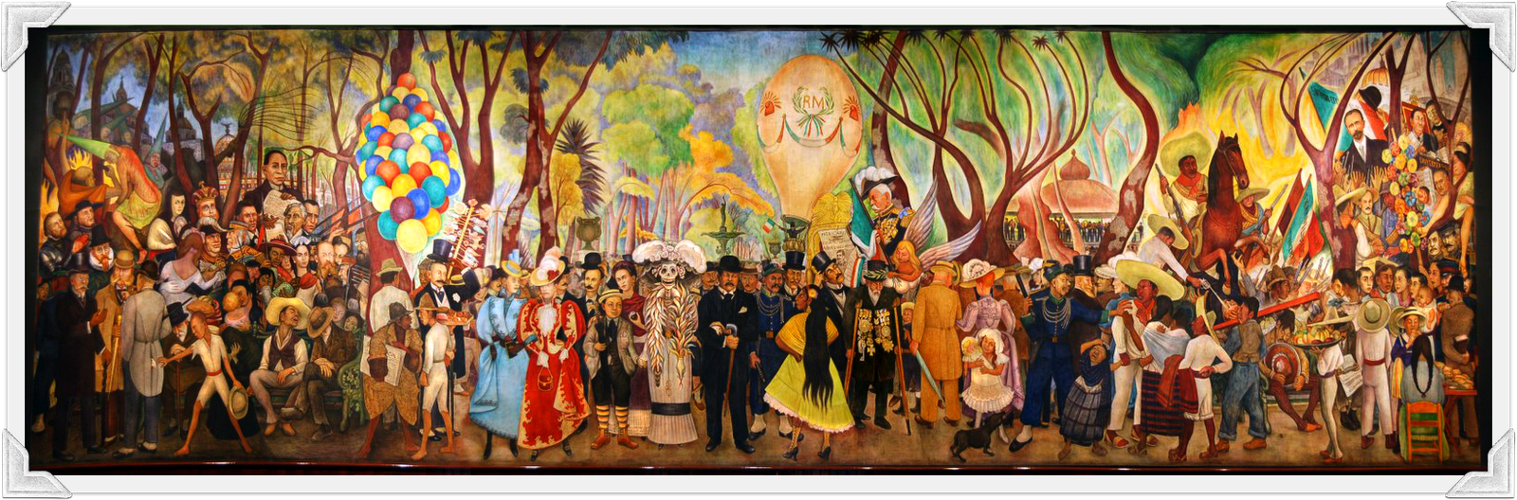
Prompt:
What is happening in this visual text? Provide evidence from the text to support your claim.
TEACHER VISUAL TEXT
Notes:
Display the Student Visual Text
Direct students to use their Think Time

Slide 42
Listen to the Model Constructive Conversation
  Use your think time to study the visual text.
Listen actively to what two partners say to each other.
Notes:
Provide a copy of the Model Script to the volunteer and allow time beforehand for student to review the script. Suggestions for reading the script:
● Show a video of students having the model conversation (optional)
● Model with a student using the Model Script.

Slide 43
Visual Text Model
What is happening in this visual text. Provide evidence from the text to support your claim.
Partner A: I think what is happening in the visual text is that people are walking in a parade through town. What do you think is happening in the visual text?
Partner A: I notice the women and children are wearing fancy gowns. The men are wearing their black suits and top hats. I think they are all part of the parade and they are showing off their fancy clothes. What evidence can you add to support your claim about the political campaign?
Partner A: I also notice there are balloons and vendors. There are also people wearing costumes. For example, the woman in the skeleton dress. I think they are providing entertainment for the people watching the parade. What additional evidence can you add to support your claim?
Partner A: I think the people in the fancy clothes and costumes are walking in the parade. I think they are making the parade entertaining by showing off their clothes and costumes.
Partner B: I think what is happening is that people are on a political campaign for an election. How can you support your claim about the parade with evidence from the text?
Partner B: There is a hot air balloon with a person in it. There are initials “RM” on the hot air balloon. I think this is the person for whom they are campaigning and he is looking for supporters. How can you further support your claim with evidence?
Partner B: I want to add that there are Mexican flags. There is a man wearing a log of medals on his suit. I also see someone placing a laurel on that man’s head. I think that he is also getting elected.
Partner B: Based on the evidence I cited from the visual text, I think what is happening is that the people are attending a political rally in support of the man wearing the medals on his suit. I think he is an elected official or a candidate who wants to be elected.

Slide 45
Listen to the Non-Model Constructive Conversation
  Use your think time to study the visual text.
Listen actively to what two partners say to each other.
Notes:
Provide a copy of the Non-Model Script to the volunteer and allow time beforehand for student to review the script. Suggestions for reading the script:
● Show a video of students having the model conversation (optional)
● Model with a student using the Non-Model Script.

Slide 46
Visual Text Non- Model
What is happening in this visual text. Provide evidence from the text to support your claim.
Partner A: I notice the people in the street having fun. They are on a Halloween parade. What do you notice?
Partner A: I notice costumes and people wearing gowns, suits and some wearing regular clothes. What do you notice?
Partner A: I know people are in costume.
Partner A: I see that people are just standing around and I see balloons.
Partner B: What I see happening in the visual text is people from a town posing for a picture.
Partner B: People have hats and gowns. They look like they are going to a party and they are all standing waiting for the picture.
Partner B: When it’s Halloween I like to dress up.
Partner B: No turn taken

Slide 47
Constructive Conversation Game
PROMPT:
What is happening in this visual text? Provide evidence from the text to support your claim.
Rules of the game:
Each of you needs one CREATE, two CLARIFY and two FORTIFY cards
Each of you will play one card as you share your CREATE, CLARIFY and FORTIFY ideas. You will continue taking turns until all cards are placed in the middle.
If you’re done early repeat the process for an additional round.
Remember to use the Constructive Conversation Norms and Skills as you play the game.
Notes:
You are now going to have the opportunity to practice the Constructive Conversation Skill FORTIFY while playing a game.
Explain the rules of the Constructive Conversation Game to students.

Slide 48
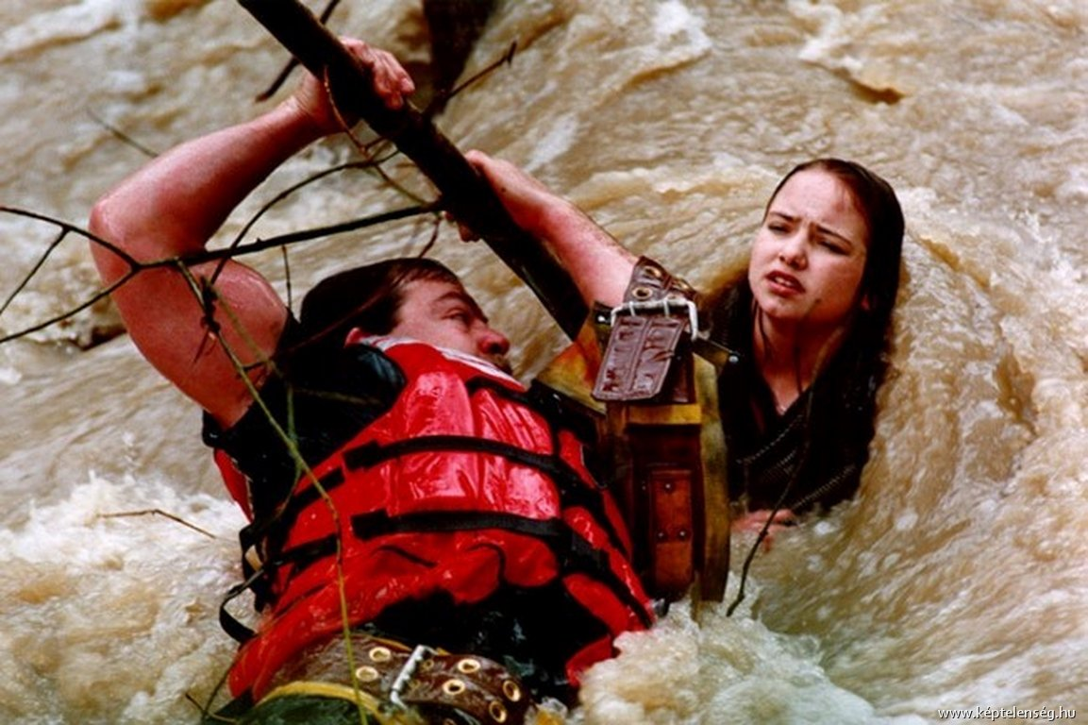
Prompt: What is happening in this visual text? Provide evidence from the text to support your claim.
TEACHER COLLECTS LANGUAGE SAMPLE SPF 1.0
STUDENT VISUAL TEXT
Notes:
Display the Student Visual Text
Direct students to use their Think Time
As the students play the game, the teacher listens and selects two students who will replay the game in front of the class to serve as models.
This is an opportunity to capture a language sample.

Slide 49
CONSTRUCTIVE CONVERSATION
FISHBOWL MODEL
PROMPT: What is happening in this visual text. Provide evidence from the text to support your claim.
Listen actively to what two partners say to each other.
FORMATIVE ASSESSMENT– TEACHER COLLECTS LANGUAGE SAMPLE SPF 1.0
Notes:
The two selected students will replay the game in front of the class and serve as models.
Student Progress Form (SPF)-­‐‑ Constructive Conversation Language Sample The teacher will collect a language sample from the two students on the Student Progress Form (SPF)-­‐‑ Constructive Conversation Language Sample to be used in Lesson 2. The language sample must be at least four turns in length. (Each turn includes both Partner A and B sharing

Slide 50
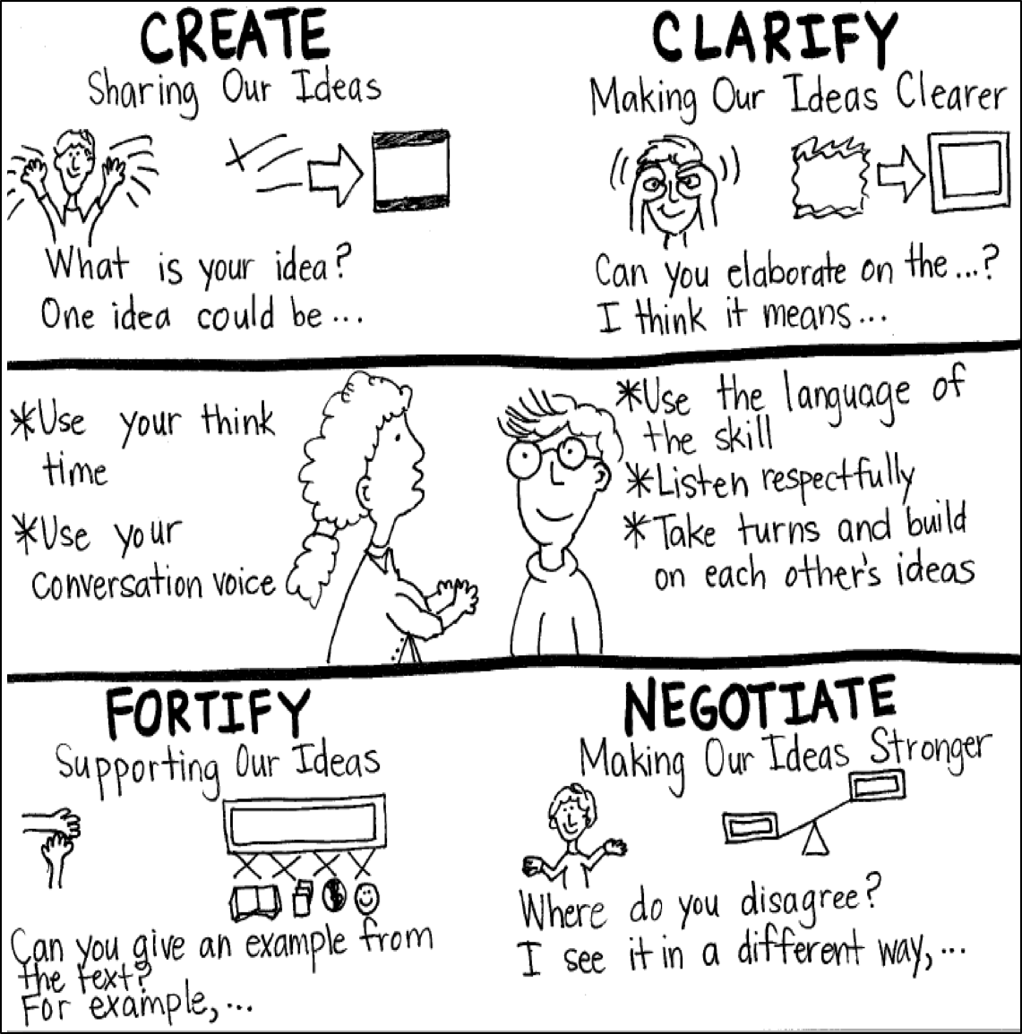
Model Creating Class Constructive Conversation Poster
Sample
Notes:
Teacher models creating a Constructive Conversation Poster. This slide is a resource. Teacher elicits student responses to help student develop a poster that illustrates their understanding of the FORTIFY skill and conversation norms.

Slide 51
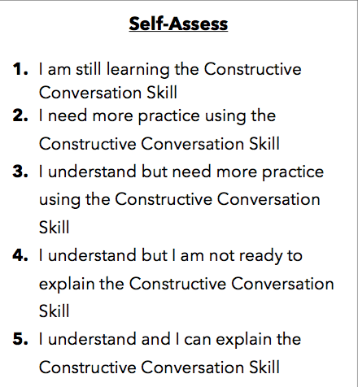
Notes:
Teacher will review the Constructive Conversation Skill FORTIFY
Students will self-assess answering the prompt
Teacher may select a conversation pair to share out.
EXAMPLE:
Student: I rated myself a 3 because…
Teacher: What can you do to move to a 4?

Slide 52
Teacher Resources

Slide 53
FORTIFY Non-Model Revision

